Slide 1


Department of Computer Science and Engineering
JOBTAKE - A GIG PLATFORM FOR JOBS USING HYBRID RECOMMENDATION
SYSTEM
ID: B21A2425C27
MUHAMMED JAZIL (210701168)
PRAGADEESHWARAN S (210701190)
DR.S.ANANTHA SIVAPRAKASAM Professor

Slide 2
PROBLEM STATEMENT AND MOTIVATION
Our motivation stems from the need to provide a more adaptable and inclusive solution for the modern workforce. By creating a platform that allows users to choose when and where they work, we aim to empower individuals to find opportunities that fit their unique schedules and interests. This approach not only supports users in achieving financial stability but also fosters skill development and personal growth. Our goal is to enhance work-life balance and offer a more dynamic and responsive solution to the challenges of the gig economy.

Slide 3
OBJECTIVES
Provide students and adults with the ability to find part-time jobs or side gigs that fit their schedules and preferences, enabling them to earn additional income.
Develop an open platform that allows users to choose work opportunities based on their availability and interests, without formal employment constraints.
Implement robust security measures and reliable systems to protect user data, and maintain platform integrity.

Slide 4
ABSTRACT
India’s gig economy continues to grow rapidly, fueled by enhanced digital infrastructure and shifting employment preferences. Flexible digital platforms are empowering gig workers across industries like home services, delivery, and freelancing, fostering financial independence and entrepreneurship. Our project leverages cutting-edge technologies such as AI-driven recommendations, peer-to-peer connectivity, and hyperlocal matching to create an inclusive and user-centric platform. By offering tailored gig opportunities and prioritizing flexibility, we aim to support India’s evolving workforce, enabling adaptable and sustainable livelihoods while addressing the diverse needs of both workers and users.

Slide 5
Literature Survey (Page1)
Title of the Paper | Summary | Journal/Conference Paper | Methodology Used | Advantages | Limitations
[1]"A Blockchain-ML Driven Freelancing Telemedicine Platform: Bangladesh Perspective” by Md. Tanzid Hossain Faqrul Hasan Shaon Akhlaqur Rahman Omi, amd Suman Ahmmed | Proposes an innovative freelancing telemedicine platform that leverages blockchain and machine learning to address healthcare delivery challenges in Bangladesh. The platform enables BM&DC-verified doctors to manage private online clinics, with gig functionality informed by surveys and analysis of existing tools. Blockchain ensures secure data sharing, while machine learning enhances the doctor-patient experience. The platform aims to revolutionize telemedicine by improving accessibility and communication. | 2023 International Conference on Information and Communication Technology for Sustainable Development DOI: 10.1109/ICICT4SD59951.2023.10303356 | Integration of blockchain and machine learning in telemedicine | Improves accessibility to telemedicine services. -Ensures secure data sharing through blockchain technology. -Facilitates seamless doctor-patient communication. -Provides real-time doctor recommendations based on patient medical history. - Offers 24/7 live chat support via WhatsApp. | -The effectiveness of machine learning recommendations may vary depending on the quality of patient data. -Potential challenges in scaling the platform due to the complexity of blockchain technology.
[2] Kumar P, S. P. S and K. S, ”Using Genetic Algorithms to Optimize Job Scheduling in Google Cloud Platform,” | The paper explores the use of genetic algorithms to optimize job scheduling on Google Cloud Platform, aiming to improve resource utilization and minimize execution time. By leveraging evolutionary techniques, the study achieves efficient scheduling of cloud tasks, highlighting the potential of genetic algorithms in enhancing performance for large-scale cloud environments. | 2024 2nd International Conference on Networking and Communications (ICNWC), Chennai, India, 2024 ,pp.16, doi:10.1109/ICNWC60771.2024.10537412. | Genetic Algorithms (GA) | Genetic Algorithms (GAs) enhance job scheduling by improving resource utilization, scalability, and reducing operational costs. They are adaptive to dynamic workloads and excel in parallel processing, making them suitable for complex and large-scale cloud environments. | However, GAs have high computational costs, increased complexity, and slow convergence rates, which can affect their efficiency, especially in large-scale systems with many variables and constraints.

Slide 6
Literature Survey (Page2)
Title of the Paper | Summary | Journal/Conference Paper | Methodology Used | Advantages | Limitations
[3] R. S. Herman and N. Sen, “Disruptive Transformation Fueling Gig Economies,” | the paper explores the disruptive transformation driving the growth of gig economies, focusing on how technology facilitates the rise of flexible employment. It highlights the impact of digital platforms, AI, and automation in reshaping labor markets and creating new opportunities for workers and businesses in the gig economy. | 2021 IEEE Technology and Engineering Management Conference - Europe, TEMSCON- EUR 2021. | Digital platforms, AI, Automation | Gig economies offer flexibility, diverse job opportunities, and autonomous work structures, allowing workers to earn income on their terms. Technology streamlines processes, enhances job matching, and boosts scalability, enabling workers to access a global market with fewer barriers and improved work-life balance. | The gig economy can lead to income instability and lack of job security for workers. Additionally, reliance on digital platforms raises concerns regarding privacy, data security, and exploitation. Gig workers may also face limited access to benefits like health insurance or retirement plans, which traditional employees typically enjoy
[4] Bates, O., Lord, C., Alter, H., Friday, A., & Kirman, B. (2021). Lessons From One Future of Work: Opportunities to Flip the Gig Economy. | This paper discusses opportunities to reshape the gig economy, focusing on future work trends and potential solutions. The authors emphasize the importance of technology in improving gig work conditions, suggesting that a more equitable and sustainable gig economy can be achieved by flipping current models to better support workers. | IEEE Pervasive Computing, 20(4), 26–34. https://doi.org/10.1109/mprv.2021.3113825. | AI, Pervasive Computing | The paper advocates for transforming the gig economy into a more sustainable and equitable model, leveraging technology to offer better working conditions, financial stability, and improved work-life balance. It highlights how gig workers could gain access to better opportunities, benefits, and security through technological advancements. | Despite the potential for improvement, shifting to a more supportive gig economy may face challenges such as resistance from established platforms, the need for widespread policy change, and the complexities of integrating new technologies across diverse sectors. Moreover, workers may still face instability and uncertainty during the transition.

Slide 7
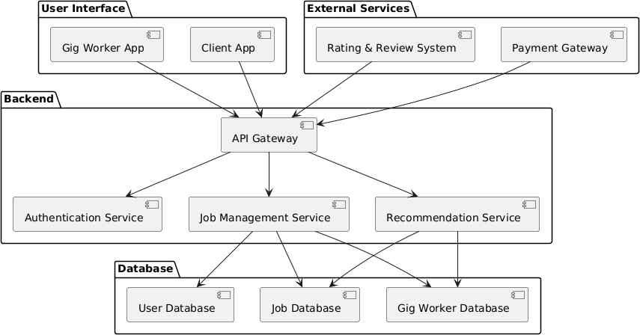
SYSTEM ARCHITECTURE

Slide 8
List of Modules
Authentication – User registration, login, verification
Job Posting – Post, Update, Remove job postings
Profile Review

Slide 9
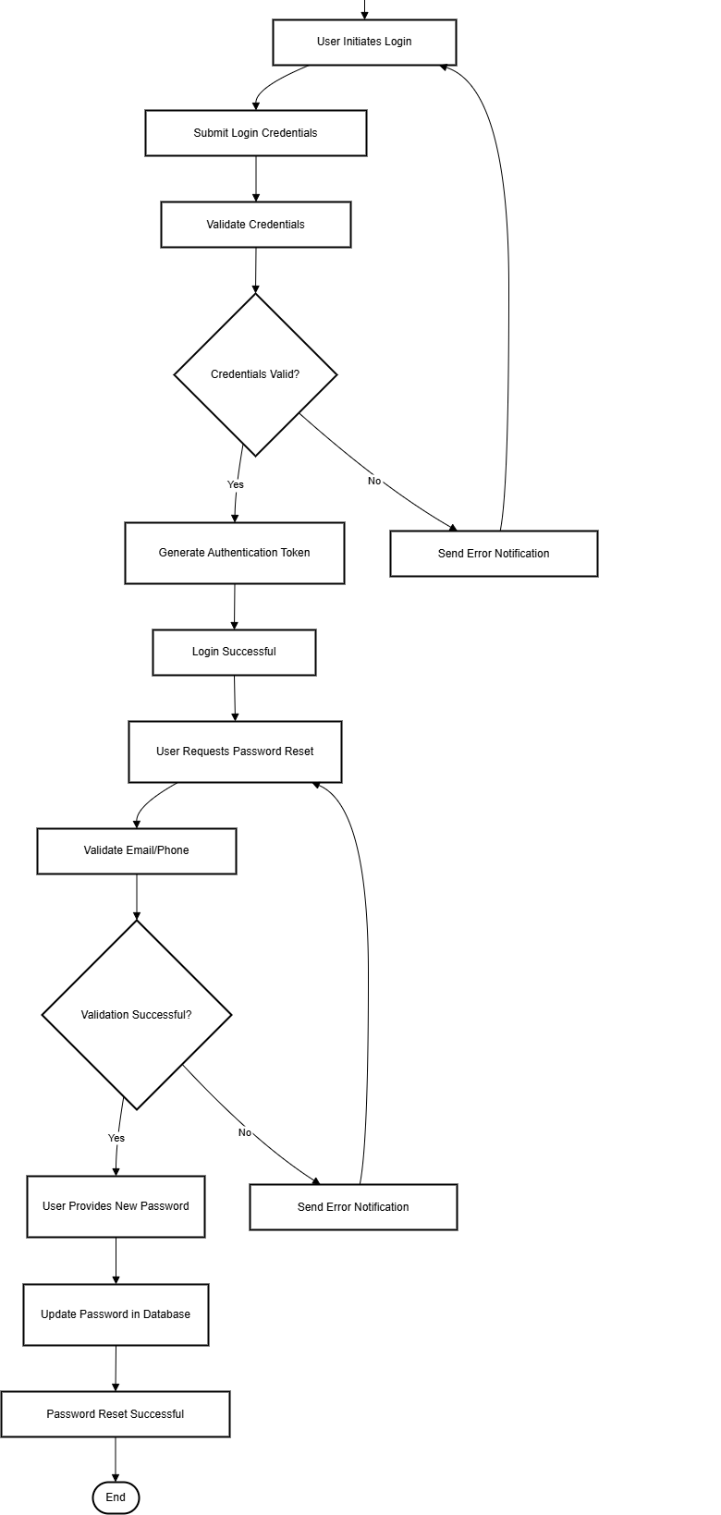
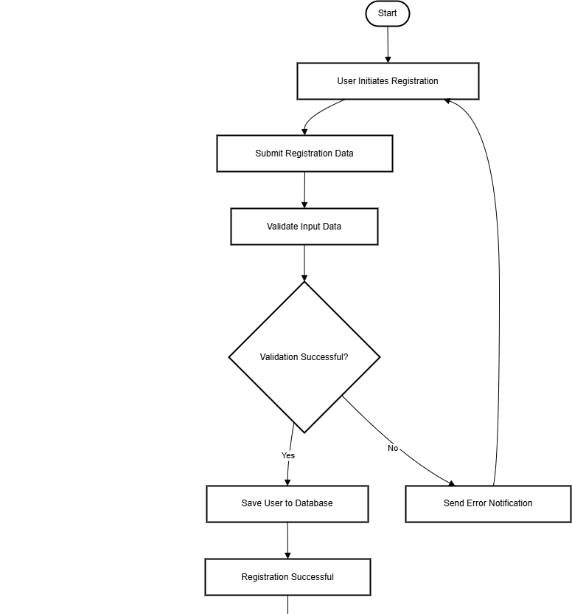
Authentication Module used for user verification and registration

Slide 10
Job Posting for User And Service Provider
Provides an user interface for posting jobs, editing and deleting and for servicemen to accept the job

Slide 11
Profile Review Module
Helps user identify if the gig service provider can take up the task and see if he is trustable

Slide 12
Conclusion & Work for Phase II
Established a unified interface for seamless interaction between users and gig workers.
Introduced intuitive job posting, peer-to-peer connectivity, and a basic chat feature for real-time communication.
Integrated a feedback system to ensure trust, accountability, and quality service.
Phase 2 Objectives:
Implement a hybrid recommendation system combining collaborative and content-based filtering for personalized job matching.
Introduce a localized service model within a 3 km radius for faster, community-driven connections.
Enhance platform scalability, efficiency, and user satisfaction.

Slide 13
REFERENCES
Kumar P, S. P. S and K. S, ”Using Genetic Algorithms to Optimize Job Scheduling in Google Cloud Platform,” 2024 2nd International Conference on Networking and Communications (ICNWC), Chennai, India, 2024 ,pp.16, doi:10.1109/ICNWC60771.2024.10537412.
R. S. Herman and N. Sen, “Disruptive Transformation Fueling Gig Economies,” 2021 IEEE Technology and Engineering Management Conference - Europe, TEMSCON- EUR 2021.
Siddique, M. Z., Basit, M., & Fatima, I. (2022). Empirical study for improving project allocation on freelancing Platform. 2022 International Conference on Innovation and Intelligence for Informatics, Computing, and Technologies (3ICT).
Bates, O., Lord, C., Alter, H., Friday, A., & Kirman, B. (2021). Lessons From One Future of Work: Opportunities to Flip the Gig Economy. IEEE Pervasive Computing, 20(4), 26–34. https://doi.org/10.1109/mprv.2021.3113825.
https://drive.google.com/drive/folders/1R71jC2_uMO9QfI_S3nEOqpr_Y74NHUBX?usp=drive_link

Slide 14
Paper Publication Status
TITLE: JOBTAKE - A GIG PLATFORM FOR JOBS USING HYBRID RECOMMENDATION SYSTEM
AUTHORS: Dr. S. Anantha Sivaprakasam
Muhammed Jazil (210701168)
Pragadeeshwaran S (210701190)
CONFERENCE:INTERNATIONAL CONFERENCE ON EMERGING RESEARCH IN COMPUTATIONAL SCIENCE – 2024
MODE OF SUBMISSION: ONLINE
STATUS: SUBMITTED AND WAITING FOR ACCEPTANCE

Slide 15
Thank You

